Slide 1

ONDC innovation-hackathon
22 Jan 2022
PhotoDada

Slide 2
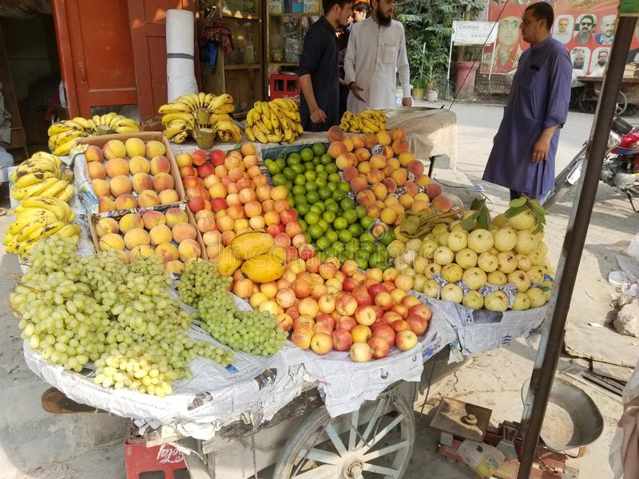

What is the problem we are trying to solve
Generate personalized catalogue for a seller from one photo (and a lot more)
Ease of use
Low cost
Accessible
Flexible
Considerations

Slide 3
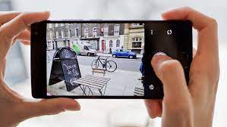
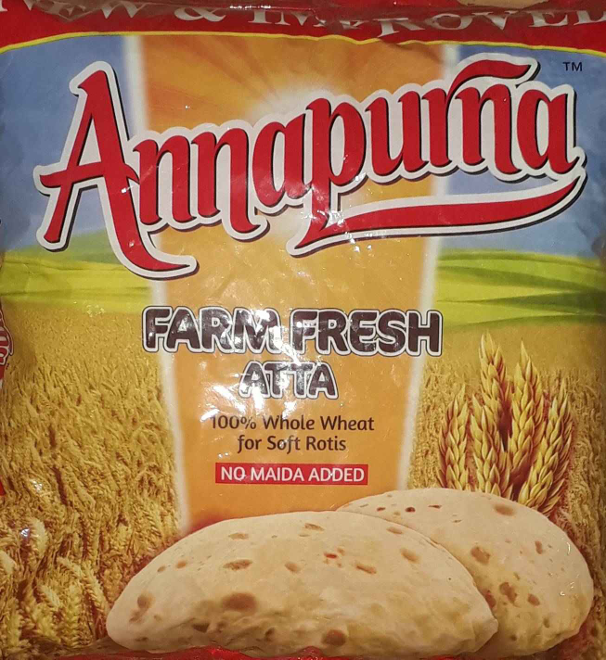

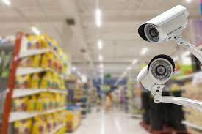

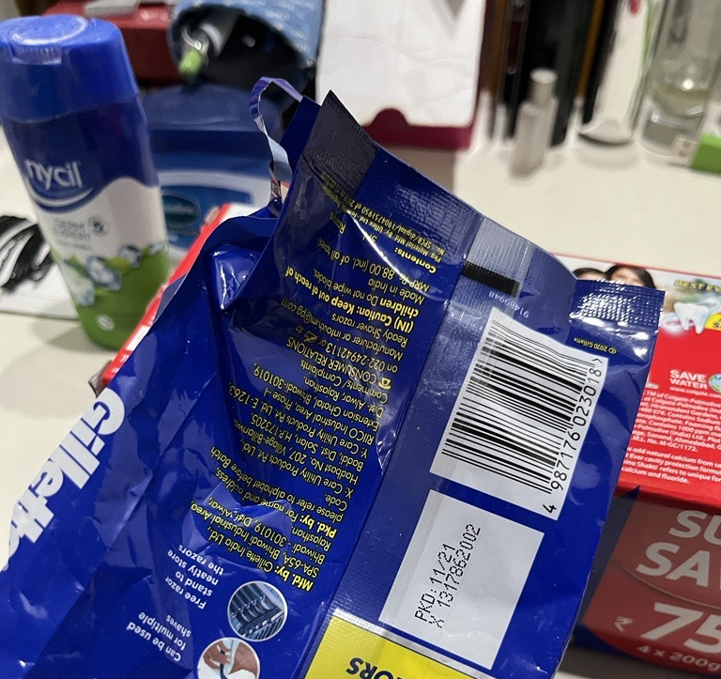
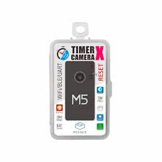
How it works
Smartphone camera
Photo
Hosted service
Catalogue
Inventory (good enough)
Capture
Realtime Videos
Send
OCR
REST / Grpc API
Applications
The algorithms, local trained model, with development pipeline and hosted for universal consumption as API service is heard of our product & proposed
Mobile client Application has been developed to show real world features to ONDC as per challenge requirement
Low cost timer cameras
Barcode

Slide 4
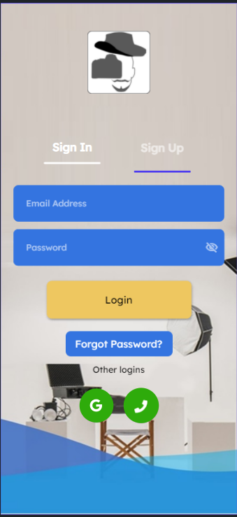
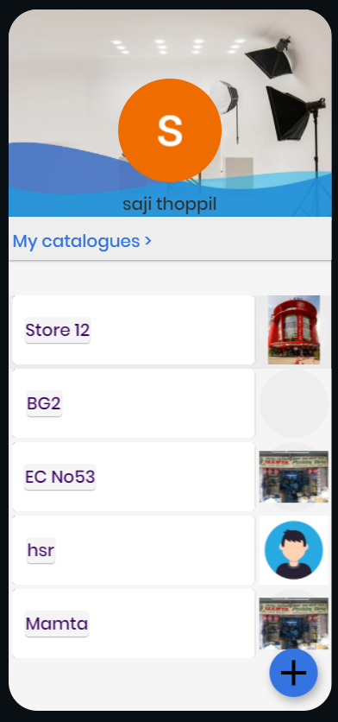
Key features of mobile client
Developed using Flutter, firebase for database
Login screen:
Authentication using google/phone/email ID
Can be made available in playstore/appstore
Option to extend to other auth methods
Self service identity
Home screen:
Personalized to user
Ability to add multiple catalogs
Show additional attributes quick recall
Get other help in curation

Slide 5
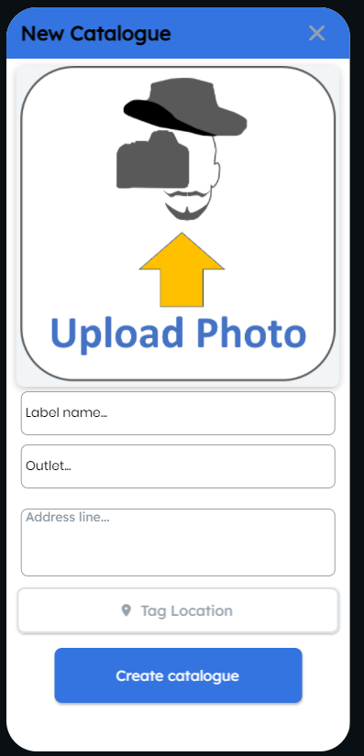
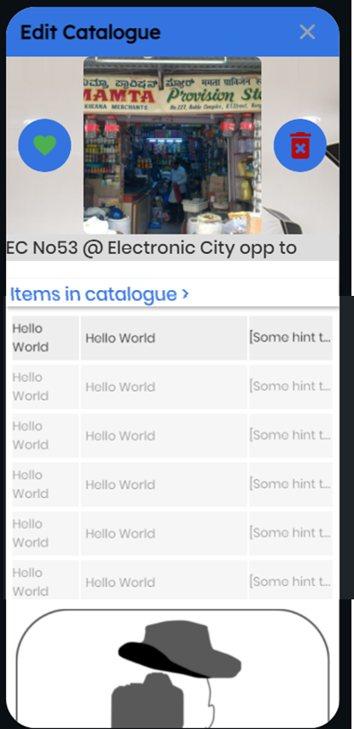
Key features of mobile client
Developed using Flutter
Catalog creation screen
Upload photos of shop front / cart
Additional attributes like location, address, map location
Easy UI interface
Catalogue viewing & updating
Personalized view for quick recall
Modify a set of attributes of each item like price/discount

Slide 6
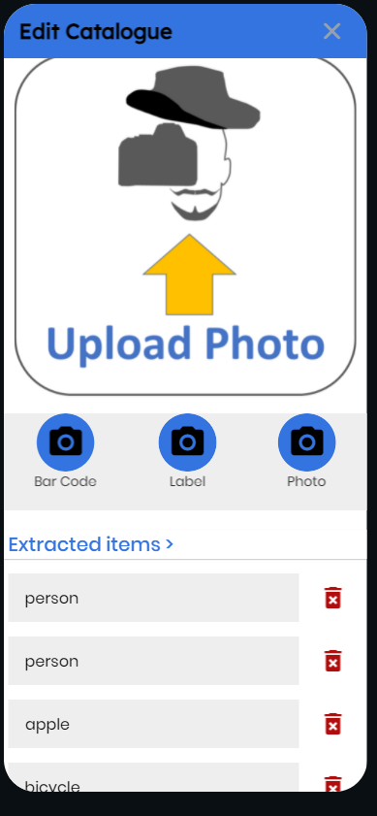
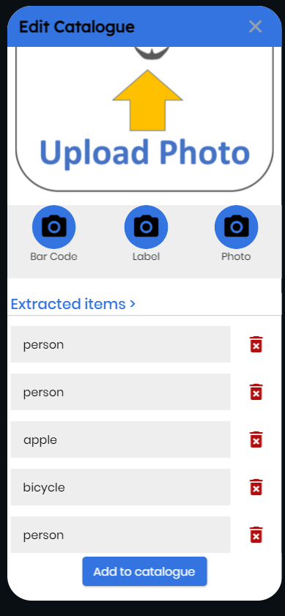
Key features of mobile client
Catalogue viewing & updating
Scan from phone or existing photo gallery
Extract multiple items interred
Delete non relevant items inferred from the photo
Add the shortlisted to the catalogue
Subsequently configure each catalogue items

Slide 7
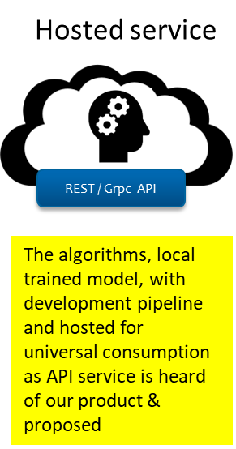
About API Service
API Gateway
(rate limiting, security, monitoring, permissions)
Designed for universal consumption
Based on deep learning & ML Model in Pytorch & Tensorflow
Opensource based with Python & libraries
Models trained on NVIDIA GPU
Cloud native architecture with Linux containers and Kubernetes based deployment
Queuing
Loadbalancers for scalling
SSL & digital certificates
API
API
Microservice: Kubernetes
Data
API
Runtime
(linux, GPU, tensor servings)
API
AI Models
Data Catalogue, taxonomy, log
Firewall & load balancers

Slide 8

Thank you

